Slide 1
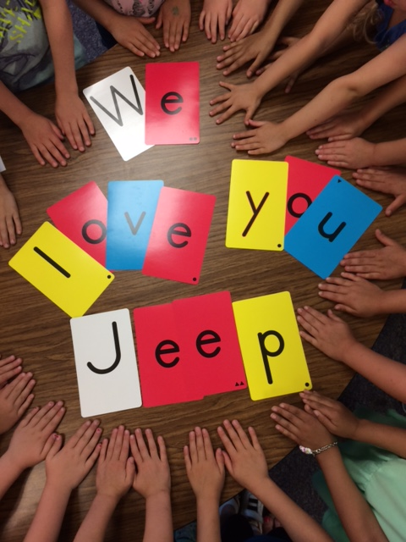
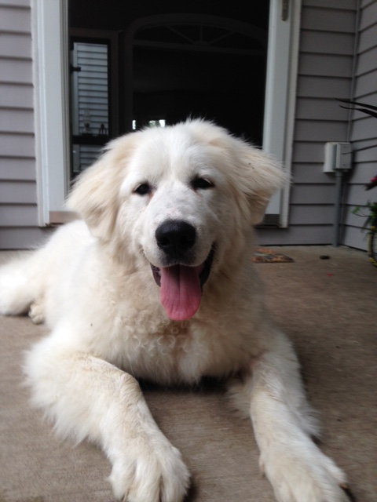
Greet Jeep
A therapy dog in training

Slide 2
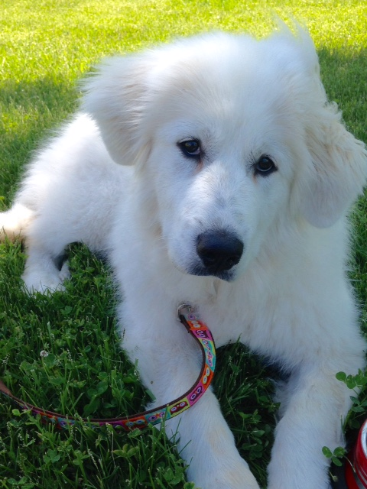
Who is Jeep?
FAST FACTS
Great Pyrenees Mountain Dog
Born in North Carolina on January 2nd
6 months old female
She now weighs 60 lbs
Training to be a therapy dog

Slide 3
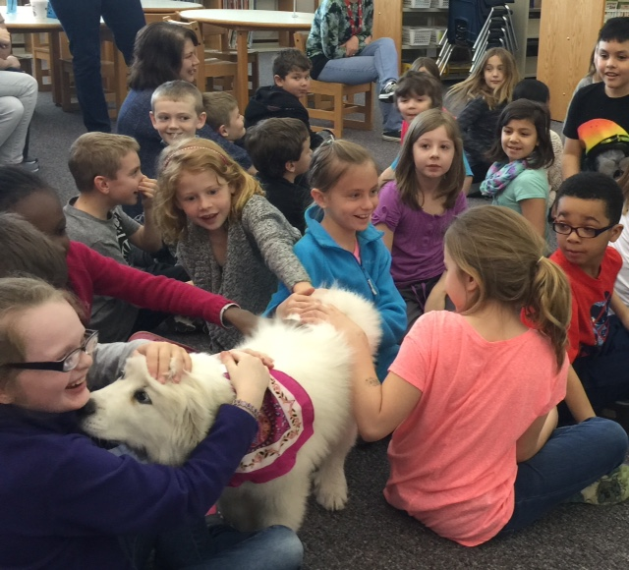
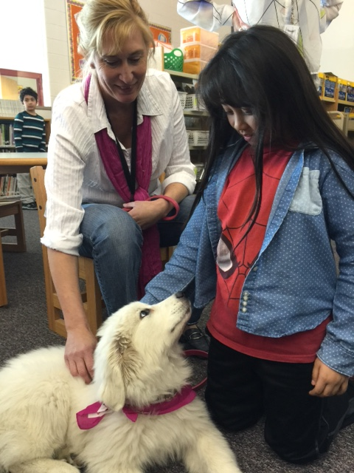
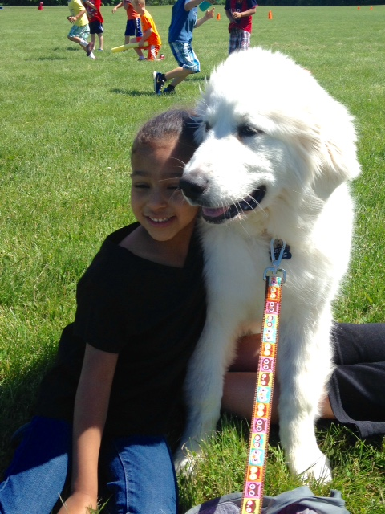
What does Jeep need to learn to become a therapy dog?
She must learn hand signals
She has to learn how to politely meet new people
She must stay calm even with new noises
She must follow all her commands
She must like her job as a therapy dog
Jeep and Dr. Zimmer have to pass a Delta International Test (every 2 years)

Slide 4
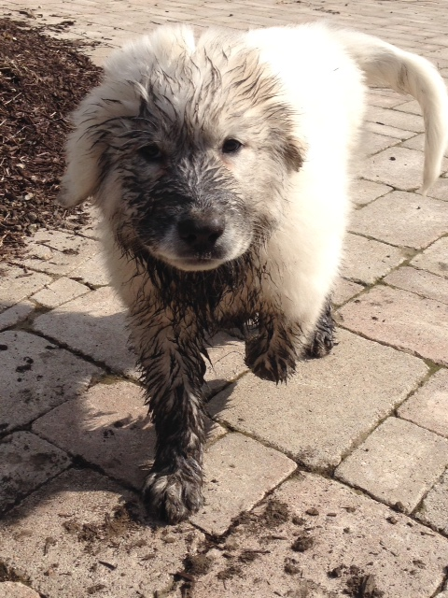
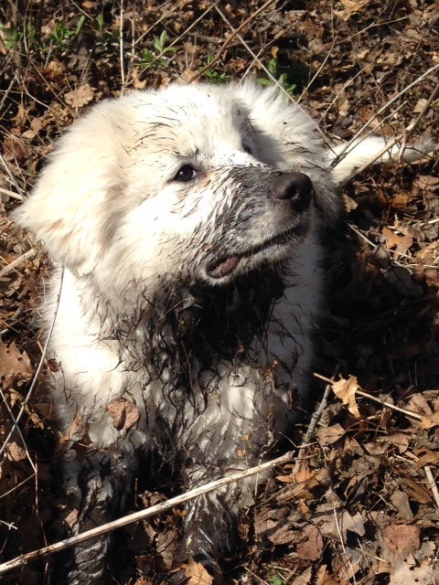
What does Jeep like to do?
She LOVES to dig in dirt
She enjoys splashing in her wading pool
She likes to go to school
She enjoys playing with other dogs, especially Dot Com
She likes to relocate objects, especially those that are mine
She likes cold weather and will stay outside for hours

Slide 5
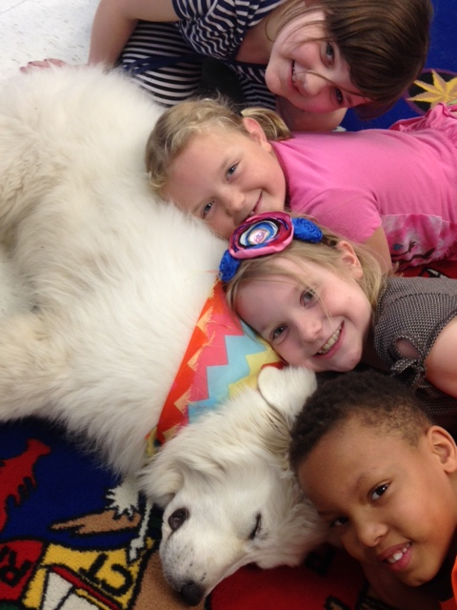
Canine Questions
Do dogs dream?
How important is the sense of
smell to a dog?
Do dogs see in color?
What foods are toxic or poisonous to dogs?
Can dogs tell how you are feeling?
Where can you find out more about dogs?

Slide 6


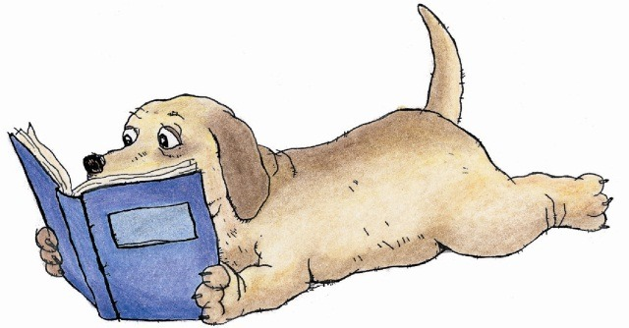

You can find out more about dogs by visiting the amazing
Lake Villa District Library!

