Slide 1
Our Unique artwork
Miss Heifner’s first graders being “Unique”

Slide 2
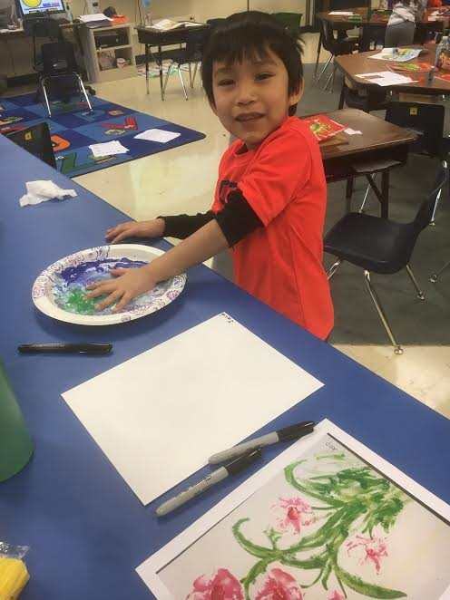
We looked at the picture which Jeep made. Jeep used her “paw” to paint some very unique flowers. We learned that no two paw prints are the same.

Slide 3
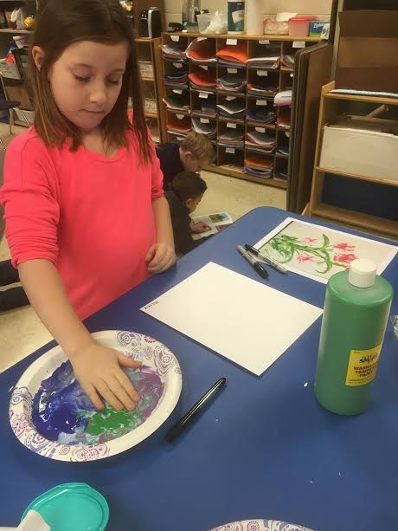
We put our “paws” in paint. The paint tickled because it was cold like an ice cube and wet. It was also squishy. The paint was interesting because there were a lot of colors.

Slide 4
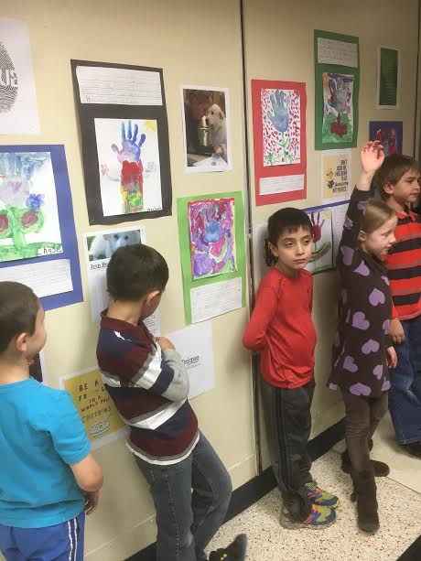
In the hallway, we raised our hands to share our writing with Mrs. Lillig’s class. We felt very happy to share our art with other first grade friends.

Slide 5
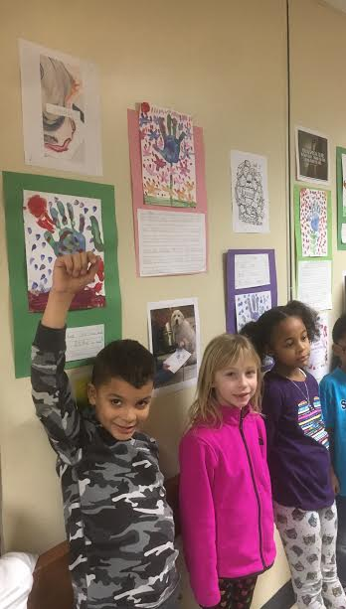
We are very proud of the work we have in the hallway. It is great to make the hallways at our school colorful and beautiful.

Slide 6
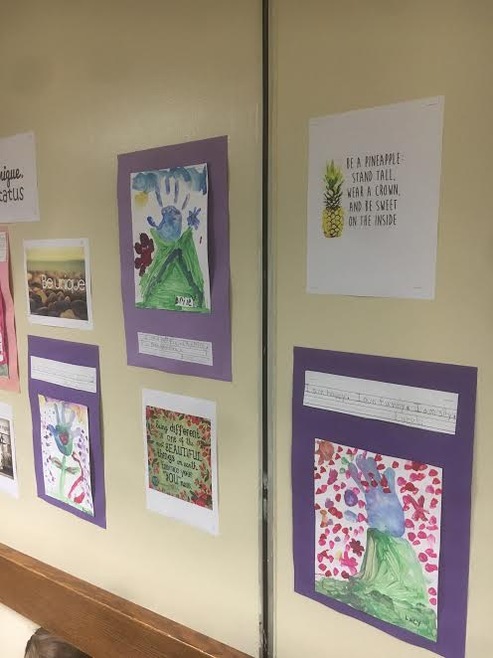
Please come down by our room to view all of the “uniqe”-NESS!!!!

